Slide 1



Long COVID Challenge: Predictive Modeling of Noisy Clinical Tabular Data
Mirna Elizondo, on behalf of N3C consortium
Datalab12
Computer Science Department
Texas State University
San Marcos, Texas

Slide 2
TABLE OF CONTENTS
INTRODUCTION
MATERIALS
METHODOLOGY
CONCLUSION
Motivation
National Covid Collaboration (N3C)
OMOP Model
Current Data
Long Covid Challenge
Preprocessing
Feature Selection
Model Development
Model Evaluation
Experiments
Results
Future Work
References
Contact

Slide 3
Motivation
Our study focuses on a significant challenge in real tabular big data science, which involves predicting Long COVID diagnosis using the NCATS' National COVID Cohort Collaborative (N3C) Data Enclave Clinical data.
The objective of the NIH Long COVID Computational Challenge (L3C) is to enhance the decision-making process for public health officials in the prevention and treatment of Long COVID.
The dataset provided for analysis encompasses information on 57,672 patients who have had COVID, including demographics, symptoms, lab test results, procedures, medications, medical conditions, physical measurements, and more.

Slide 4


National Covid Collaboration (N3C)
What is the National COVID Collaborative or the N3C?
An electronic system of health record-based de-sensitized data sets related to Covid-19 pandemic and patients. This data is harmonized, mapped, and curated by the Center for Data to Health (CD2H). [1]
The data and information created in the Enclave system are bound to it following level-2 clearance with DUR.
Mission: “Identify patients and controls by establishing a common COVID-19 phenotype that will define the data pull for the limited data set, create a "white glove" service to obtain data from each site by building easily adaptable scripts for each clinical data model, and ingest data into a secure location, per approved institutional agreements”[2]
Images Courtesy of Palantir Foundry Tools[2]

Slide 5
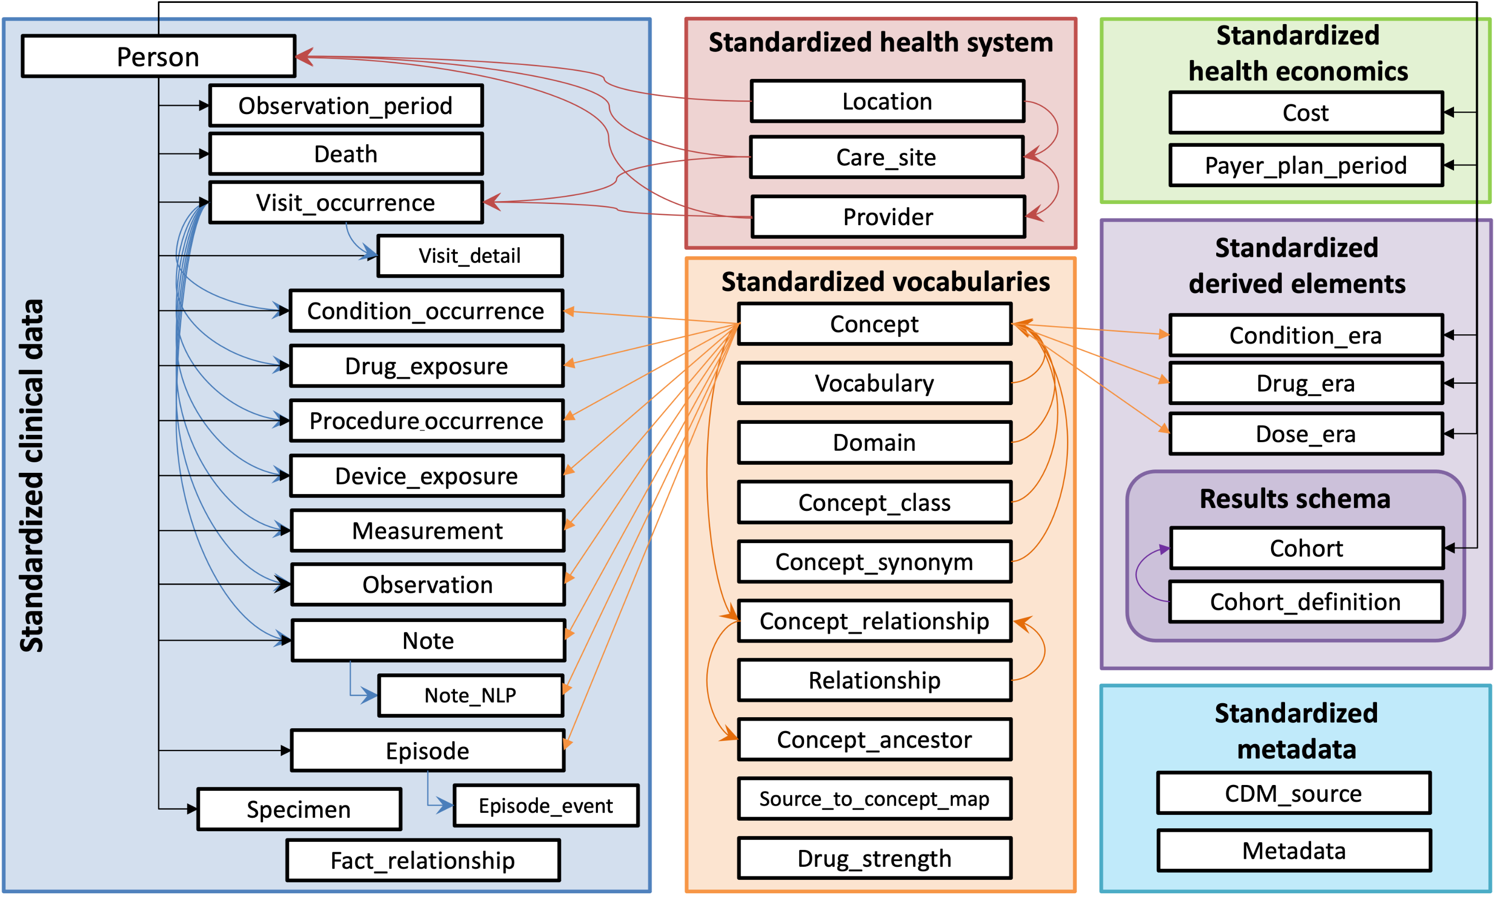
OMOP Model
“The Observational Medical Outcomes Partnership (OMOP) Common Data Model (CDM) is an open community data standard, designed to standardize the structure and content of observational data and to enable efficient analyses that can produce reliable evidence” [3]

Slide 6
Current Data
N3C Multi-Source Patient Linkage and Patient De-Duplication:
N3C data enhancement: site-to-site patient de-duplication using Privacy Preserving Record Linkage (PPRL)- PPRL used to link EHR records to supplemental data like mortality information
Ability to link patient records across data partners participating in PPRL
41/78 data partners committed to site-to-site linkage- 24/78 data partners committed to mortality linkage
40/45 data partners participating in Medicaid linkage
Palantir Foundry and N3C promoting partner participation- Enclave represents 5% of the USA population (1 in 20 people)
Global patient identifiers to optimize pipeline and models for better population representation
19,601,787 Total N3C Patients
7,645,226 Confirmed Covid-19 (+)
194,853 Possible Covid-19 (+)
26.2 Billion Total Rows

Slide 7
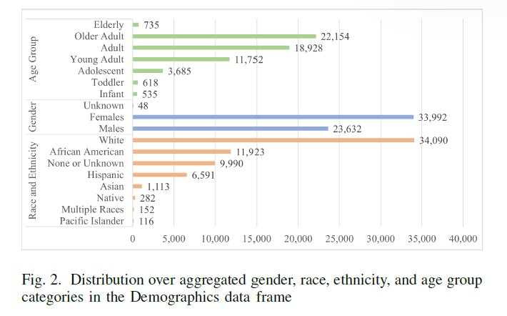
Long Covid Challenge (L3C)
The Long COVID Computational Challenge (L3C) aimed to develop AI/ML models to identify patients at high risk of developing Long COVID. Our task was to train machine learning algorithms to determine the probability of Long COVID in COVID-19 patients, focusing on outpatient and hospital settings (ICU or non-ICU). The challenge lasted five months, starting in August, to improve decision-making for Long COVID prevention and treatment.
Challenge Question: "Among patients who have tested positive for SARS-CoV-2 in outpatient or hospital settings (ICU or non-ICU), what is the probability of developing PASC/Long COVID?"

Slide 8
Pre-Processing
Data Set | Rows X Columns (% missing values)
 | Train | Test
care_site | 8,367 x 8 (66%) | 26 x 8 (1%)
condition_era | 2,484,521 x 8 (0%) | 13,639 x 8 0%
condition_occurrence | 6,316,765 x 21 (37%) | 36,451 x 21 (35%)
condition_to_macro | 1,286,673 x 8 (6%) | 8,388 x 8 (5%)
device exposure | 422,167 x 19 (44%) | 2,836 x 19 (45%)
drug_era | 2,090,455 x 9 (0%) | 12,698 x 9 (0%)
drug_exposure | 13,611,559 x 28 (42%) | 66,050 x 28 (39%)
location | 25,142 x 9 (57%) | 281 x 9 (60%)
long COVID | 57,675 x 2 (13%) | 300 x 2 (0%)
manifest_safe | 69 x 6 (23%) | 300 x 13 (23%)
measure | 32,569,723 x 29 (33%) | 198,151 x 30 (33%)
measure_to_macro | 17,839,906 x 8 (0%) | 112,243 x 8 (2%)
micro_to_macro | 3,524,398 x 28 (54%) | 19,430 x 26 (54%)
note | 321,151 x 19 (59%) | 2,710 x 19 (66%)
note_nlp | 7,580,262 x 21 (38%) | 60,486 x 21 (45%)
observation | 6,869,266 x 25 (49%) | 43,355 x 25 (43%)
observation_period | 45,404 x 7 (0%) | 234 x 7 (0%)
payer_plan_period | 1,370,746 x 26 (69%) | 6,029 x 26 (69%)
person | 57,672 x 26 (29%) | 300 x 26 (28%)
procedure_occurrence | 278,981 x 19 (22%) | 14,645 x 19 (23%)
procedures_to_macro | 991,579 x 8 (5%) | 5,247 x 8 (5%)
provider | 31,664 x 18 (51%) | 477 x 18 (56%)
visit_occurrence | 350,934 x 23 (49%) | 19,411 x 23 (49%)
Our base population includes patients with a COVID-19 diagnosis or positive post-acute sequelae of SARS-CoV-2 test.
The provided Long COVID Silver Standard data contains two columns: "person_id" and "covid_index.“
The label for training data is the "pasc_after_four_weeks" column, indicating Long COVID positivity after four weeks.
Out of 57,672 patients, 9,031 tested positive for Long COVID. We aggregated and utilized this information to generate data frames for analysis.
The training set consists of 11,446 patient records diagnosed with Long COVID before or after four weeks from the COVID index, excluding 2,415 records taken four weeks prior. All final data frames are considered in our study.

Slide 9
Feature Selection
Each proposed feature importance method selects a subset of features based on minimum redundancy and maximum relevancy.
(1) Variance threshold filtering (2) Lasso regularization of logistic regression (penalty L1 term) (3) Random Forest embedding (4) Random forest Recursive Feature Elimination (RFE) (5) Recursive Feature Elimination (RFE) with Ridge Regression (6) Random Forest method and with (7) The sequential Feature Selection (SFS) model selects an optimal set of features by searching the feature space of all combinations in a greedy manner. We evaluated each subset of features that add one predictor at a time forward based on the 5-fold cross-validation score of the (8) Ridge regression regularization.
Notes:
(1) Variance threshold filtering removes attributes by eliminating all low-variance attributes in the training set. (2) Lasso regularization of logistic regression (penalty L1 term) shrinks the coefficients by minimizing the loss function during training. (3) Random Forest embedding has a built-in feature importance measured by the Gini importance or mean decrease impurity. We propose to set the 50th percentile threshold for the importance of the attribute to include a relevant attribute in the final set. (4) Random forest Recursive Feature Elimination (RFE) with Random forest first fits the full set of attributes in our data set, and we eliminate features with the smallest coefficients if they deteriorate the 10-fold cross-validation score of the models in the training data. (5) Recursive Feature Elimination (RFE) with Ridge Regression eliminates features with the smallest coefficients if they deteriorate the 10-fold cross-validation score of the models in the training data. Permutation Feature Importance(PFI) with (6) Random Forest method and with (7) Ridge Regression methods replace the values of a feature with redundant noise and measures the difference in the accuracy score or other performance metrics between the baseline and the permuted data set. The sequential Feature Selection (SFS) model selects an optimal set of features by searching the feature space of all combinations in a greedy manner. We evaluated each subset of features that add one predictor at a time forward based on the 5-fold cross-validation score of the (8) Ridge regression regularization. We apply the importance attribute rankings to separate frames captioning demographics, conditions, observations and drugs, and to the fused frame of demographics, conditions and drugs attributes, the Diagnoses frame

Slide 10
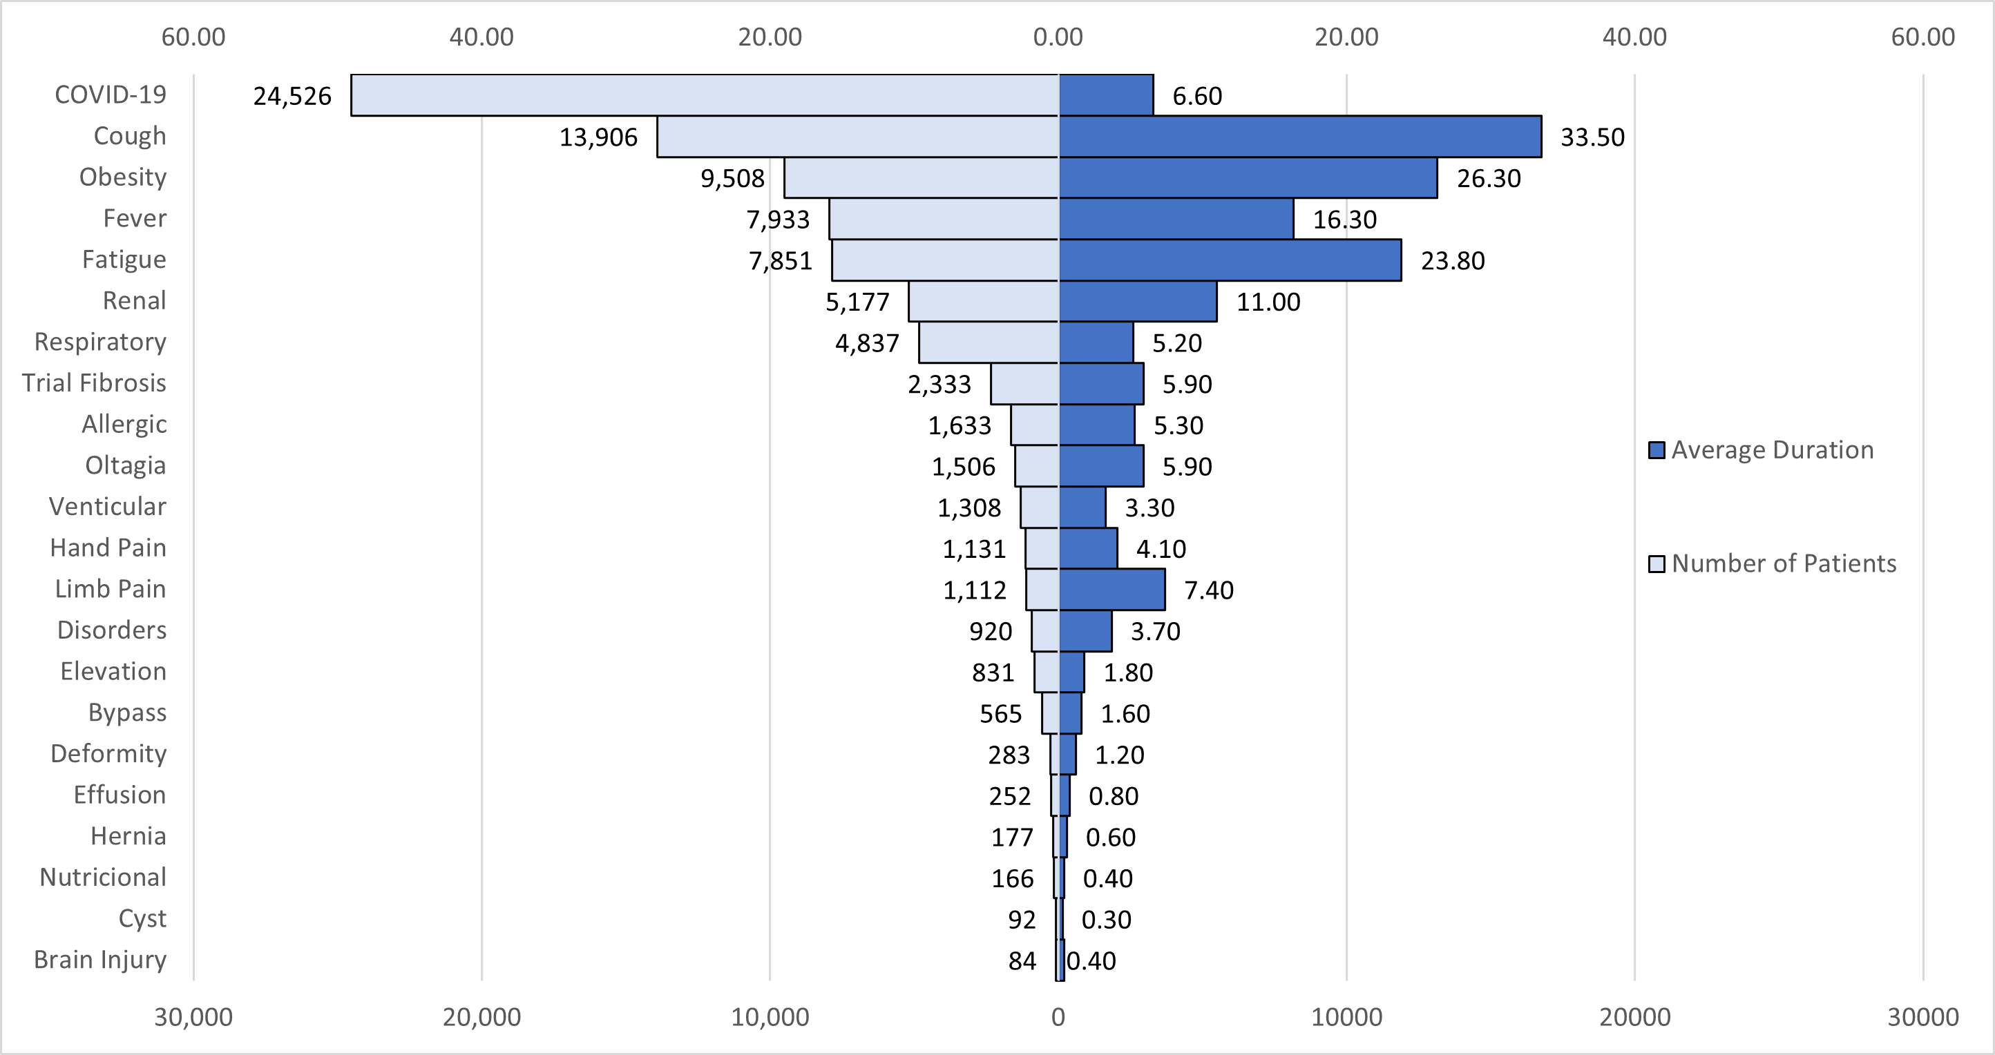
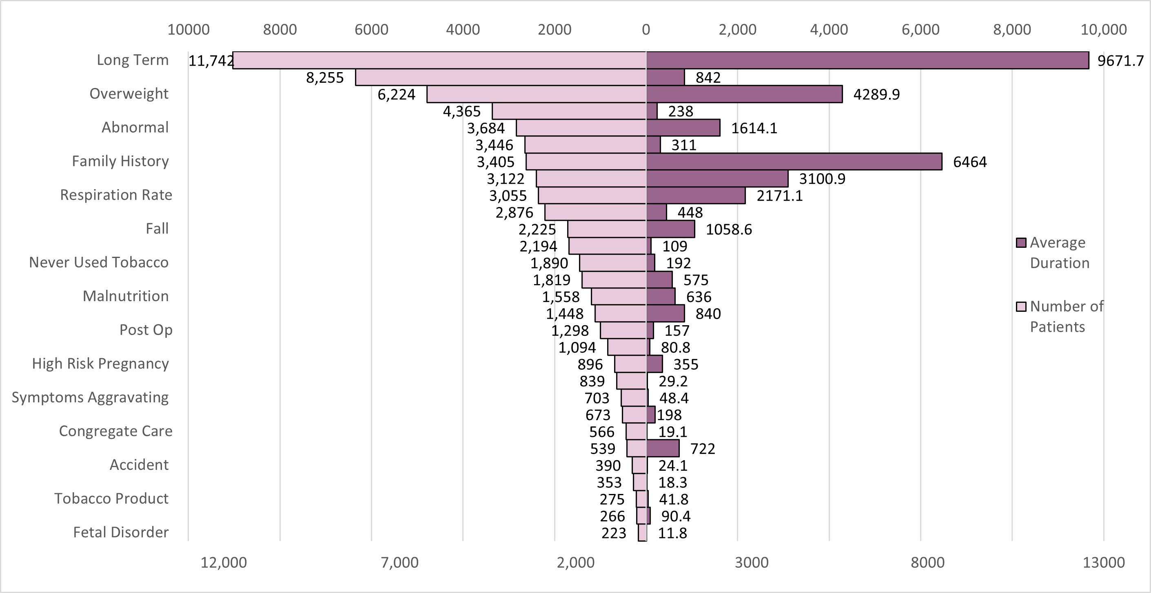
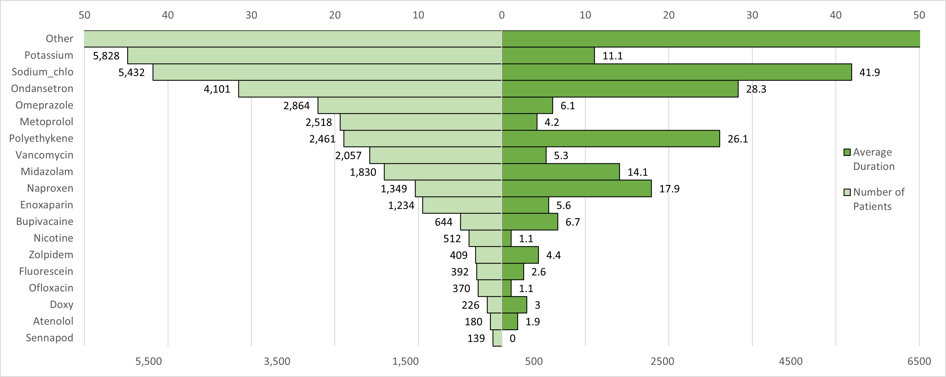
Most Frequent Features
Figure 2. The most frequent conditions per patient in the training data set (left) and their average duration (right).
Figure 3. The most frequent observations per patient in the training data set (left) and their average duration (right).
Figure 4. Most frequent drugs per unique patient in the training data set (left) and their average duration (right).

Slide 11
Model Development
Multi-step logistic regression is an extension of logistic regression that handles multi-step classification problems.
Decision trees use a tree-like structure to make decisions based on feature values.
Random forest combines multiple decision trees for improved accuracy and robustness.
Gradient boosting sequentially combines weak learners, often decision trees, to create a powerful predictive model.
Dataset | # Patient | # Concepts | # Represented
Conditions | 38,044 | 14,764 | 24
Observations | 38,340 | 2,744 | 34
Drugs | 35,872 | 14,159 | 23
Diagnosis | 38,340 | 31,667 | 64

Slide 12
Model Evaluation
Precision measures the proportion of correctly predicted positive instances out of all instances predicted as positive. It focuses on the accuracy of positive predictions, indicating how well the model avoids false positives. A high precision value suggests that the model has a low rate of falsely labeling negative instances as positive.
Recall, also known as sensitivity or true positive rate, measures the proportion of correctly predicted positive instances out of all actual positive instances. It captures the model's ability to identify positive instances correctly, indicating how well it avoids false negatives. A high recall value suggests that the model has a low rate of falsely labeling positive instances as negative.
F1 score combines precision and recall into a single metric, providing a balanced measure of a model's performance. It is the harmonic mean of precision and recall, and it considers both false positives and false negatives. F1 score is particularly useful when there is an imbalance between the classes or when both precision and recall are equally important.

Slide 13
Experiments
 | Gradient Boosting |  |  | Random Forest
data frame | P | R | F1 | P | R | F1
Demographics | 0.792 | 0.845 | 0.780 | 0.869 | 0.845 | 0.780
Conditions | 0.750 | 0.785 | 0.760 | 0.780 | 0.799 | 0.760
ConditionsB | 0.750 | 0.785 | 0.750 | 0.770 | 0.793 | 0.760
 | Decision Tree |  |  | Random Forest
data frame | P | R | F1 | P | R | F1
Demographics | 0.871 | 0.848 | 0.780 | 0.870 | 0.845 | 0.780
Conditions | 0.770 | 0.794 | 0.760 | 0.780 | 0.799 | 0.760
ConditionsB | 0.760 | 0.792 | 0.760 | 0.770 | 0.793 | 0.760
Observations | 0.760 | 0.782 | 0.750 | 0.790 | 0.808 | 0.770
ObservationsB | 0.760 | 0.781 | 0.750 | 0.770 | 0.793 | 0.750
Diagnoses | 0.750 | 0.783 | 0.740 | 0.850 | 0.850 | 0.840
DiagnosesB | 0.750 | 0.780 | 0.740 | 0.780 | 0.792 | 0.760
Performances For The Entire Training Data Set. The Encoding Of The Total Days For Conditions Observations And Diagnoses Made No Statistical Difference For The Modeling

Slide 14
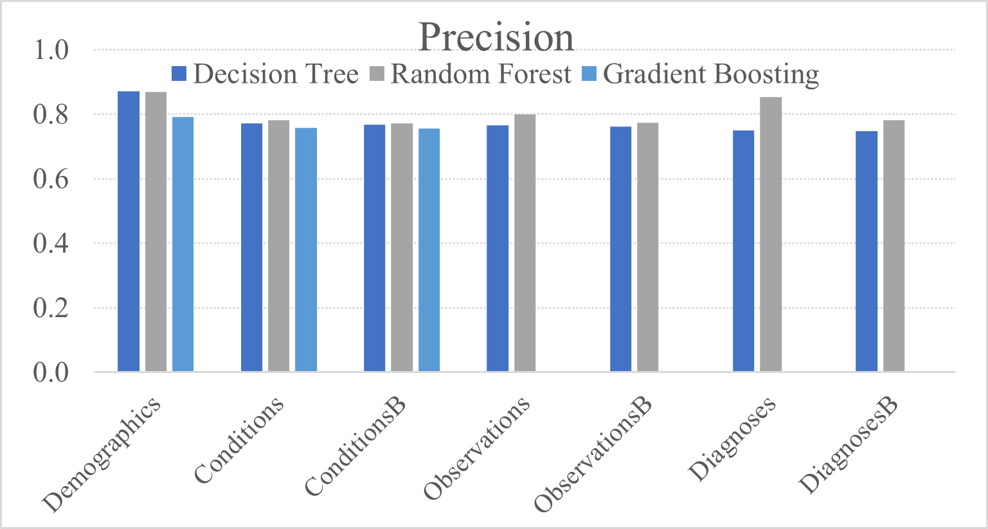
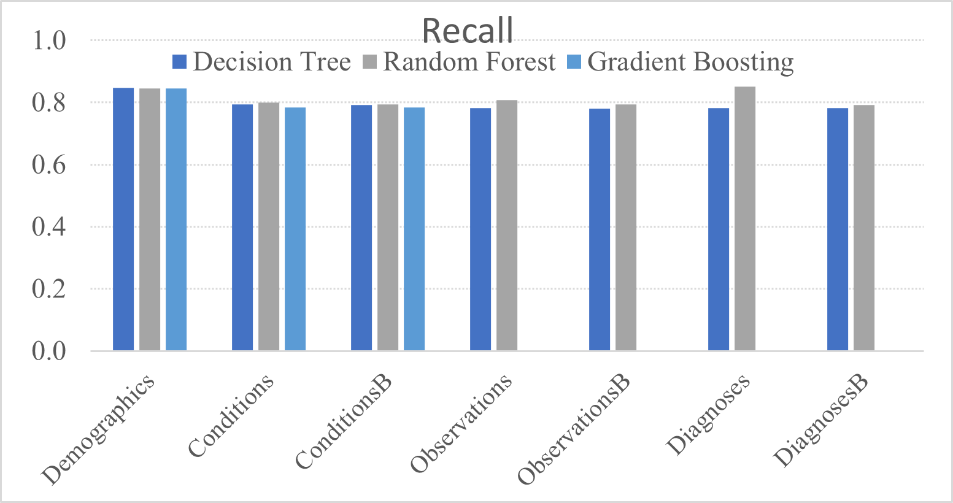
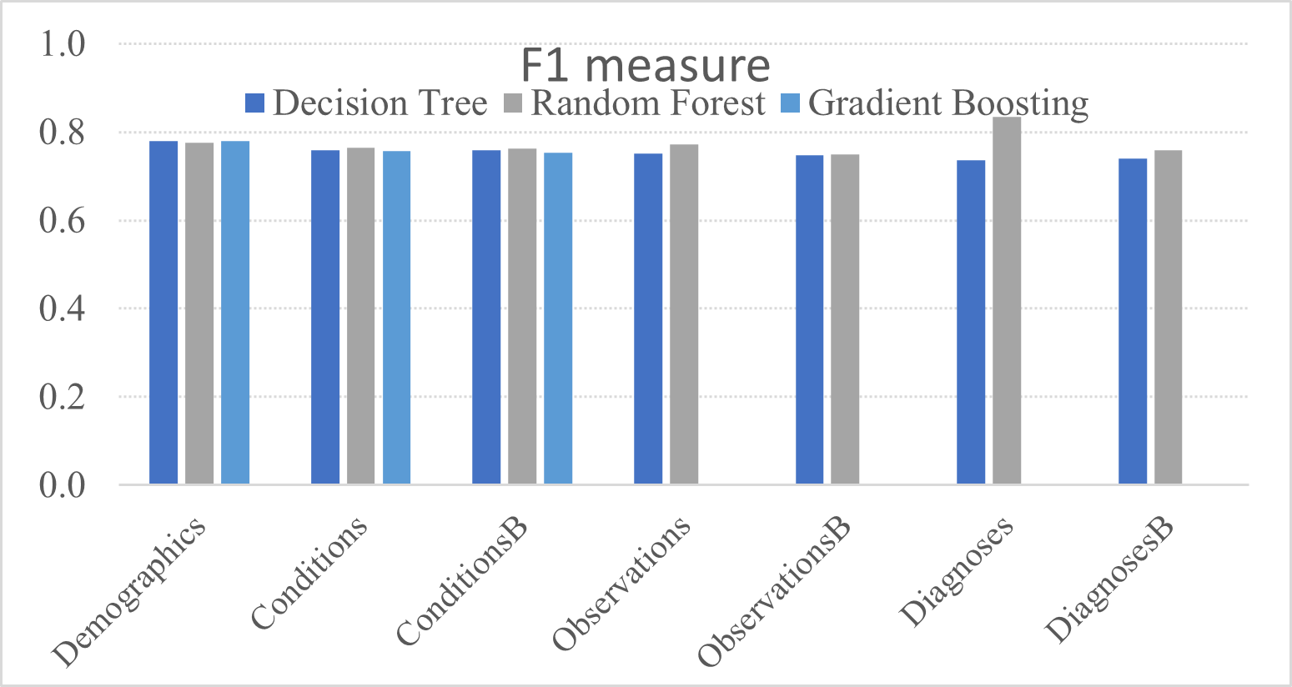
Random Forest Results
Precision, Recall and F1 comparisons for the Decision Tree Model, Random Forest and Gradient Boosting Models

Slide 15
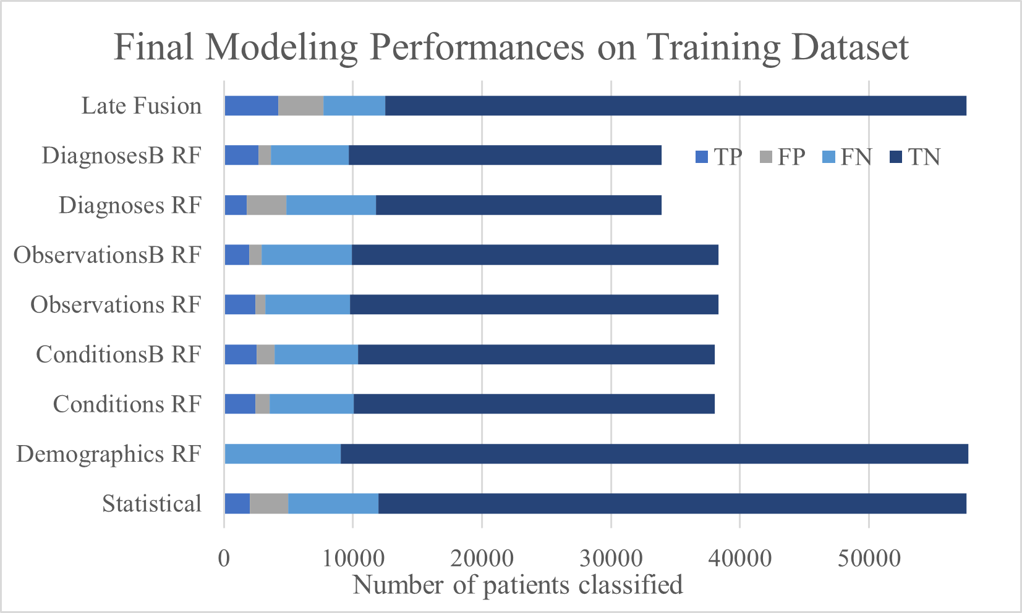
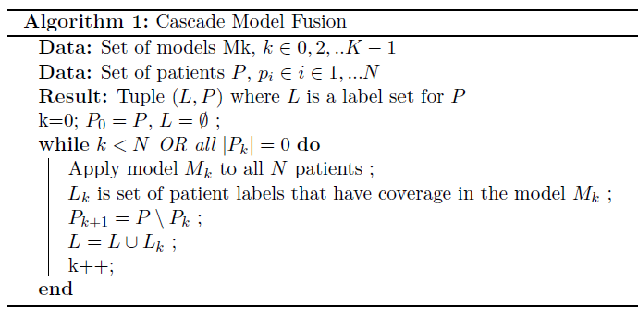
Fusion Cascade Modeling

Slide 16
Final model performance results for training set.
Model | data set | TP | FP | FN | TN | P | R | F1
Statistical | Early Fusion | 2,031 | 2,967 | 7,000 | 45,564 | 0.406 | 0.225 | 0.290
Random Forest | Demographics | 98 | 0 | 8,933 | 48,641 | 1.000 | 0.011 | 0.021
Random Forest | Conditions | 2,449 | 1,085 | 6,544 | 27,966 | 0.693 | 0.272 | 0.391
Random Forest | ConditionsB | 2,546 | 1,402 | 6,447 | 27,649 | 0.645 | 0.283 | 0.393
Random Forest | Observations | 2,432 | 799 | 6,555 | 28,554 | 0.753 | 0.271 | 0.398
Random Forest | ObservationsB | 1,980 | 922 | 7,007 | 28,431 | 0.682 | 0.220 | 0.333
Random Forest | Diagnoses | 1,764 | 3,070 | 6,935 | 22,130 | 0.365 | 0.203 | 0.261
Random Forest | DiagnosesB | 2,659 | 991 | 6,040 | 24,209 | 0.728 | 0.306 | 0.431
Late Fusion | Alg. 1 | 4,216 | 3,482 | 4,816 | 45,048 | 0.548 | 0.467 | 0.504

Slide 17
Future Work
In our next steps, we aim to automate the aggregation and selection of features for all unique drugs, conditions, observations, and procedures fields. Additionally, we plan to improve the Enclave processing for scalability, addressing the limitations of the current system.
Currently, our primary focus is on enhancing the accuracy of mortality prediction in the female cohort following the COVID-19 pandemic. We are utilizing a custom loss function in a multi-step statistical learning pipeline, employing state-of-the-art Gradient boosting models such as XGBoost, LightGBM, and CatBoost. Furthermore, we are developing an ensemble model that utilizes majority voting.
The objective of this study is to provide evidence-based recommendations considering the long-term consequences associated with Long COVID.
Long COVID Subtypes and Risk Factors: A Definition for Long COVID:
In the aftermath of the COVID-19 pandemic, a definition for long COVID was established based on the signs, symptoms, and diagnoses that showed a higher frequency after a positive COVID test compared to before testing. The definition encompasses 323 ICD-10-CM diagnosis codes grouped into 143 functional groups, identifying 17 medical-specialty long COVID subtypes. It was observed that patients with more severe cases of COVID-19 and multiple comorbidities were more likely to develop long COVID. This highlights the need for monitoring and treatment programs tailored to individuals at risk.

Slide 18
References
[1] National Covid Cohort Collaborative (N3C). (n.d.). National Covid Cohort Collaborative (N3C). Retrieved April 18, 2023, from https://covid.cd2h.org/n3c
[2] Phenotype &amp; Data Acquisition Workstream. Phenotype &amp; Data Acquisition Workstream | N3C. (n.d.). Retrieved April 18, 2023, from https://covid.cd2h.org/N3C_phenotype
[3] OMOP. (n.d.). Common Data Model. OMOP Common Data Model. Retrieved April 18, 2023, from https://ohdsi.github.io/CommonDataModel/index.html
Acknowledgments:
The analyses described in this presentation were conducted with data or tools accessed through the NCATS N3C Data Enclave https://covid.cd2h.org and N3C Attribution & Publication Policy v 1.2-2020-08-25b supported by NCATS U24 TR002306, Axle Informatics Subcontract: NCATS-P00438-B. This research was possible because of the patients whose information is included within the data and the organizations (https://ncats.nih.gov/n3c/resources/data-contribution/data-transfer-agreement-signatories) and scientists who have contributed to the on-going development of this community resource [https://doi.org/10.1093/jamia/ocaa196].

Slide 19
CONTACT US

http://datalab12.github.io/

m_e172@txstate.edu
Department of Computer Science
601 University Drive
San Marcos, Texas 78666


